Slide 1
PSI – ROTO design layout
Last updated: 20 November 2016

Slide 2



Icon

Slide 3

Splash screen

Slide 4
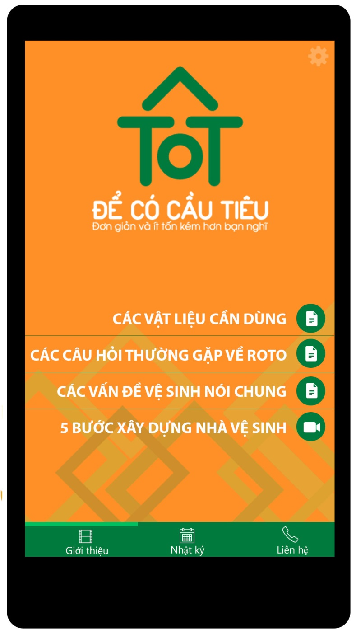
Introduction

Slide 5
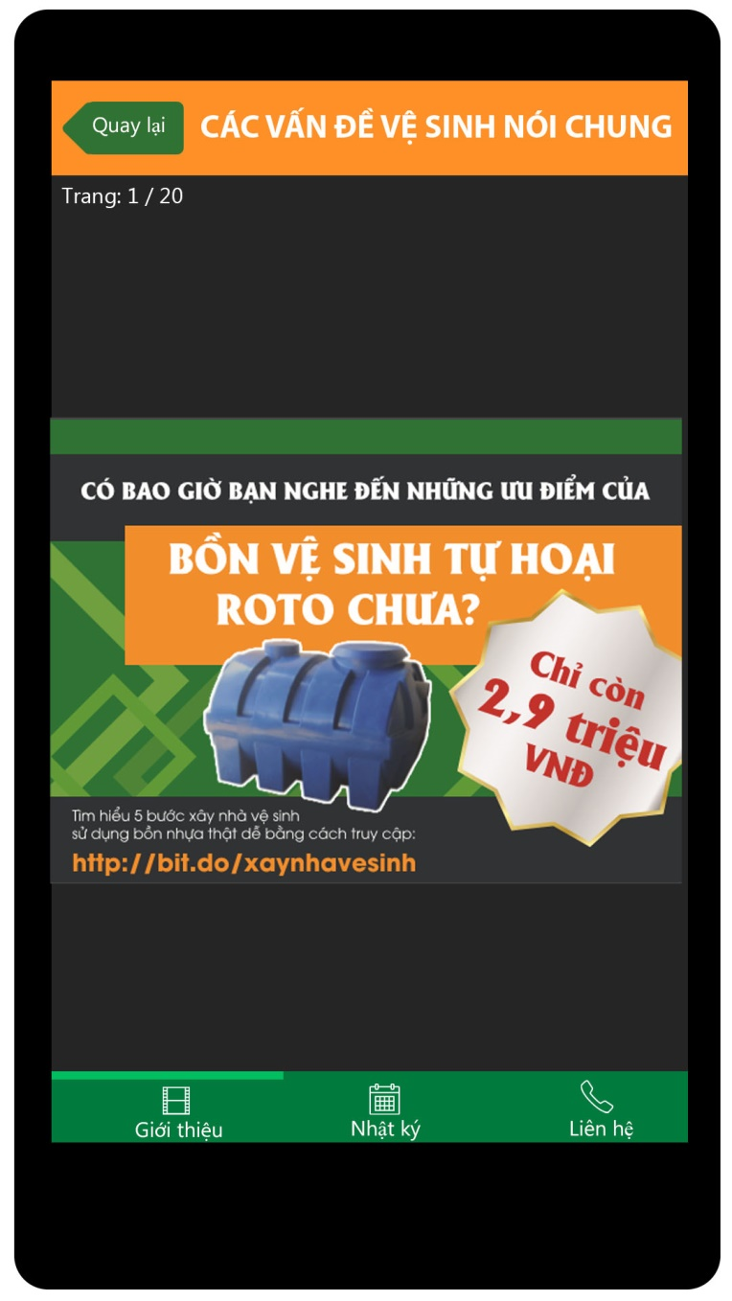
Introduction - slide

Slide 6
Introduction - video
Coming soon

Slide 7
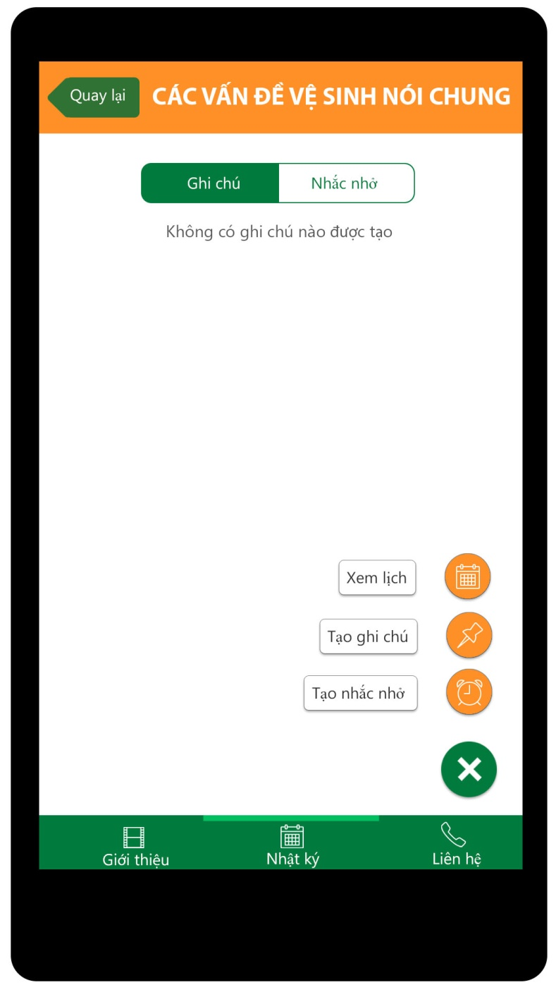
Note - layout

Slide 8
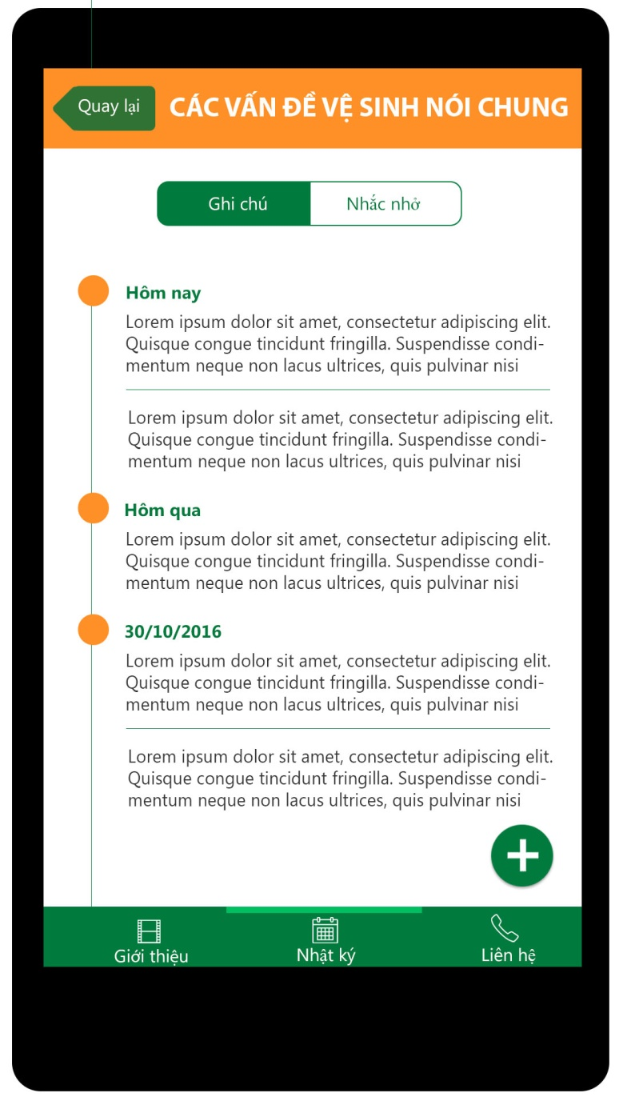
Note - Note

Slide 9
Note – Create Note
Coming soon

Slide 10
Note - Reminder
Coming soon

Slide 11
Note – Create Reminder
Coming soon

Slide 12
Note – Calendar
Coming soon

Slide 13
Contact
Coming soon

Slide 14
Setting
Coming soon

